Slide 1
Retrospective Investigation of Histological Compatibility between Colposcopic Directed Cervical Biopsy and Conization Material
Zuhal Uzun¹
Prof. Gürkan Kıran²
¹Bezmialem Vakıf University, Faculty of Medicine, Istanbul, Turkey
²Bezmialem Vakıf University, Faculty of Medicine, Department of Gynecology and Obstetrics, Istanbul, Turkey

Slide 2
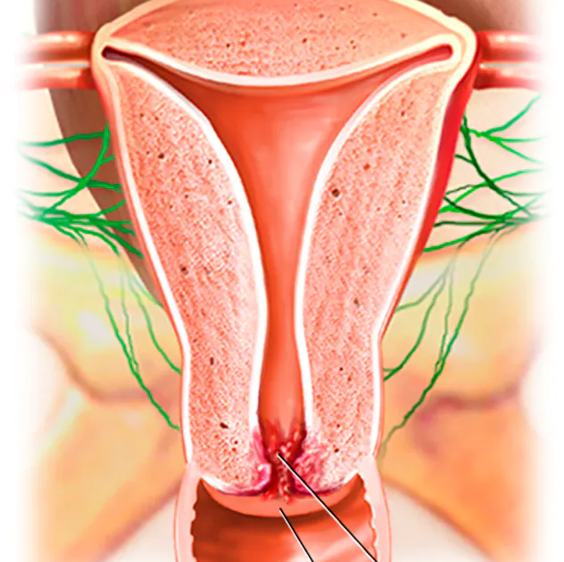
INTRODUCTION
Cervical cancer is the second most common malignancy in women worldwide after breast cancer [1]. In Turkey, its incidence is 4.5/100,000 of the Turkish women population.

Slide 3
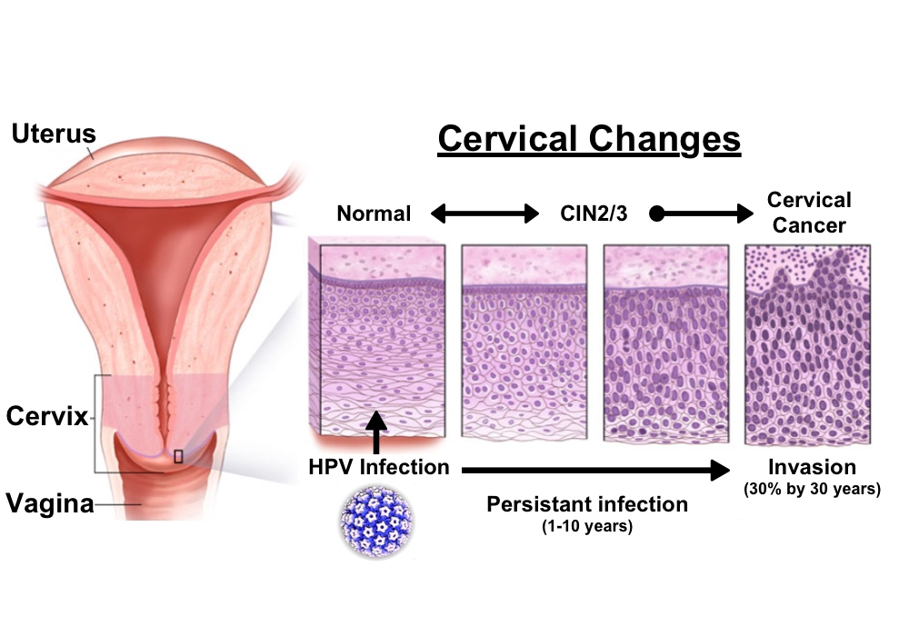
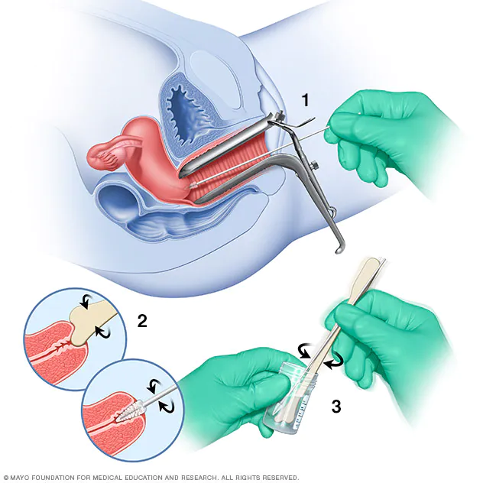
Otherwise, cervical cancer constantly develops over the course of several years, therefore early detection and treatment of cervical dysplasia is crucial in preventing the progression to cancer and improving patient outcome [2].
Cervical cancer incidences and deaths have decreased since the implementation of cervical cancer screening with cervical cytology and human papillomavirus (HPV).

Slide 4
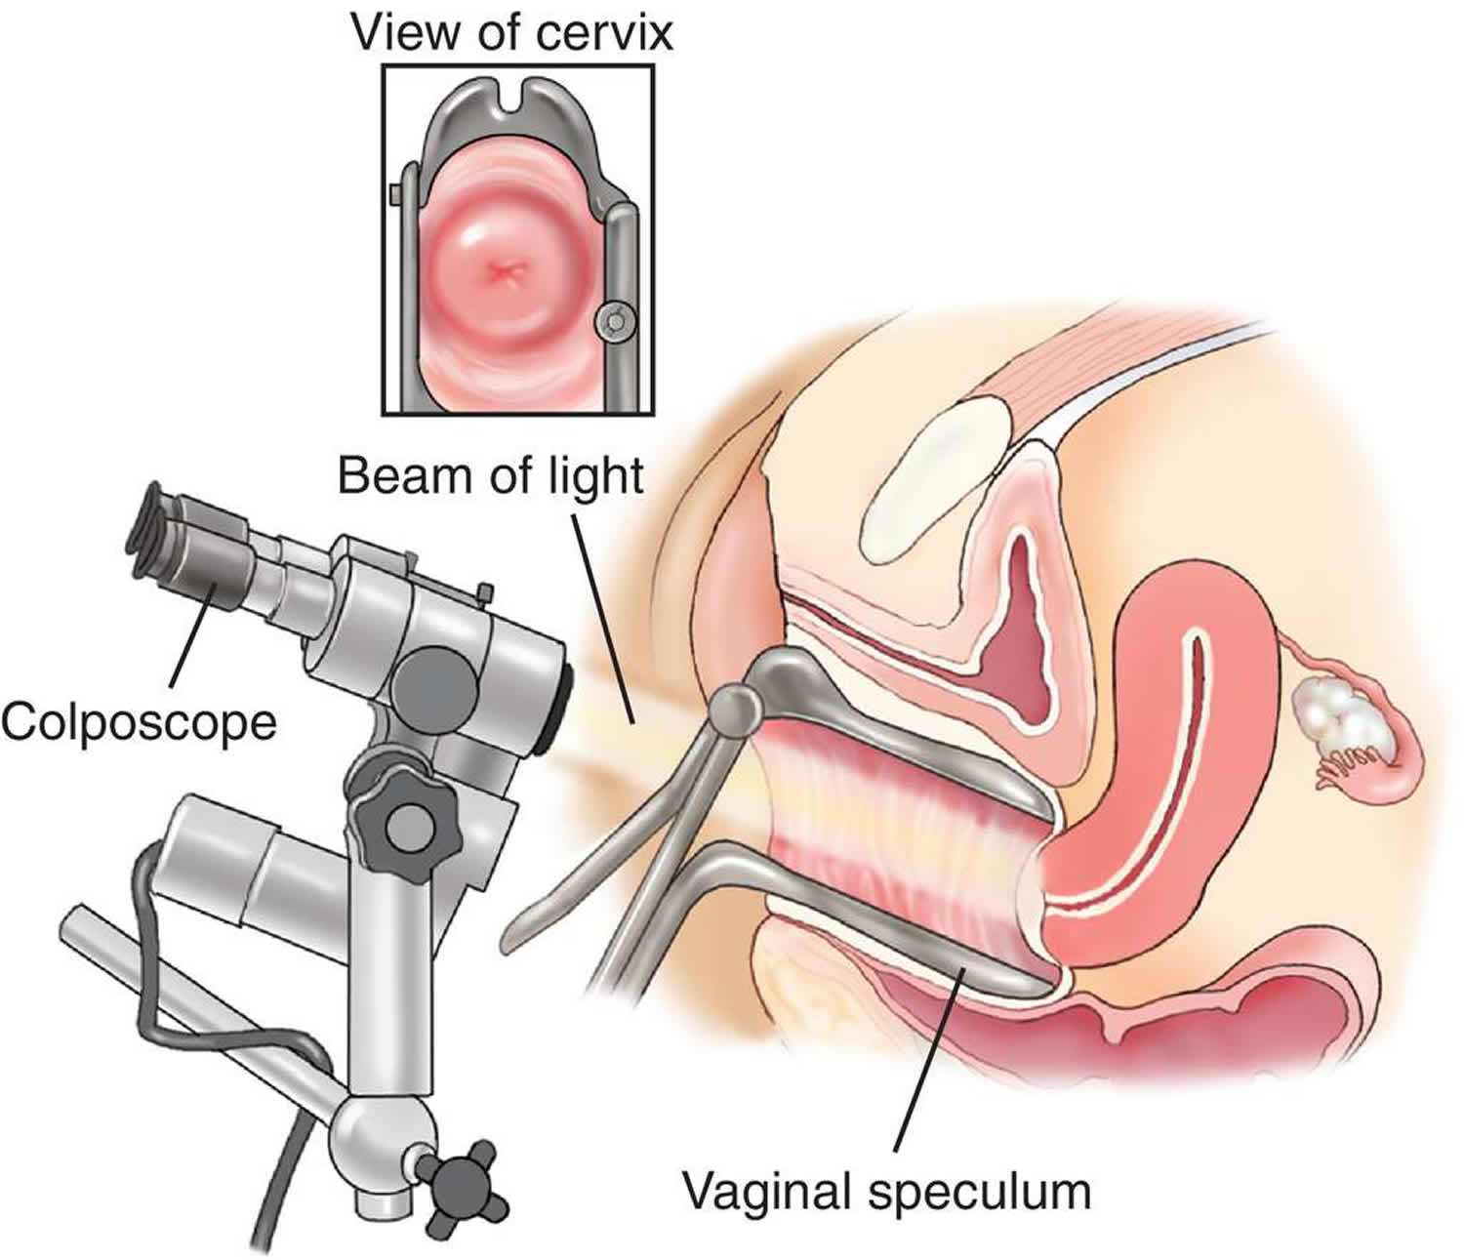
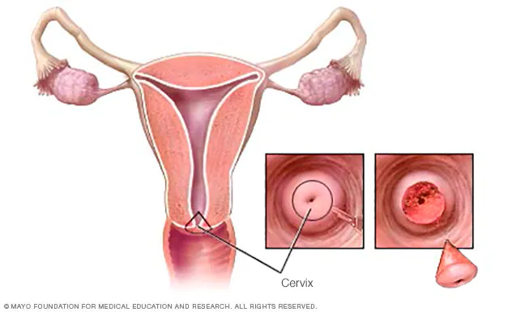
• To sustain definitive diagnosis and management simultaneously, conisation stands for a less invasive and first step procedure [4].
Colposcopy is the gold standard method for evaluating a normal smear and positive high risk HPV results [3].
In this study, we aimed to evaluate the compatibility between colposcopic diagnosis and cervical pathology a retrospective investigation was performed.

Slide 5
MATERIALS AND METHODS
This study included 100 patients who underwent colposcopy and cervical biopsy or cervical conization at Bezmialem Vakıf University Medicine Faculty Hospital from January 2010 – November 2020. Clinical characteristics of the patients (age, parity, menopause state, BMI, HPV vaccine, HPV types), cervical cytology results, colposcopic diagnosis, cervical pathology results were recorded and correlations between variables were analyzed.
When we consider calculating the compatibility of the methods in our research with each other with the kappa coefficient, and since it was seen that importance was given to a kappa coefficient of approximately 0.60 in the sample article, it was calculated that 92 cases were required for a 95% confidence level and 80% power.
The coefficient of consistency was calculated with kappa. The study data were evaluated using SPSS 20.0, IBM software.

Slide 6
RESULTS
This study included 704 patients. The patients who had incomplete or unsuitable data were excluded. Therefore, 100 patients have remained for analysis. The mean age of study group was 42,71 years. The mean body mass index (BMI) of the study group was 24,1787. While the number of menopausal patients was 27, 73 patients were still menstruating. 1 patient previously received the HPV vaccine. The mean parity number was 1,91. The HPV types results were negative in 23 patients, type 16 and/or 18 positive in 51 patients and other HPV-HR (High Risk HPV) groups (31, 33, 35, 39, 45, 51, 52, 56, 58, 59, 66, 68) positive in 26 patients.
Characteristics | Cases
Mean age of study group | 42,71
Mean body mass index (BMI) | 24,1787
Number of menopausal patients | 27
Number of patients were still menstruating | 73
Mean parity number | 1,91
Negative HPV types results | 23
Type 16 and/or 18 positive patients | 51
Other HPV-HR groups positive patients | 26
Epidemiologic characteristics of patients included in study

Slide 7
The cervical cytology results were available in 99 patients included negative cytology in 10 patients, ASC-US in 21 patients, ASC-H in 17 patients, LSIL in 32 patients, HSIL in 19 patients. Colposcopy was diagnosed as benign in 5 patients (these consisted of cervicitis, squamous metaplasia, insignificant change), low grade lesion in 24 patients, high grade lesion in 71 patients. The cervical pathology was reported as benign in 21 patients, LSIL in 22 patients, HSIL in 52 patients (including CIN2 and CIN3), MIC in 1 patient and invasive cancer in 4 patients.

Slide 8
CONIZATION
COLPOSCOPY
NORMAL/ BENIGN
LSIL
HSIL -
MIC/INVASIVE CANCER - -
TOTAL 5 24 71 -
BENIGN 2 2 1
LOW GRADE LESION 7 8 9
HIGH GRADE LESION 12 12 43 4
The Agreement between Colposcopic
Diagnosis and Cervical Pathology
MIC/INVASIVE CANCER - - -
TOTAL 21 22 52 5 100
The consistency of colposcopic diagnosis and cervical pathology was matched in 56 patients. The strength of agreement with the weighted Kappa statistic was 0.443 . The strength of agreement between colposcopic diagnosis and cervical pathology was found to be only moderate.
Colposcopic diagnoses are more often overestimated (30%) than underestimated (14%).

Slide 9
CONCLUSION
The strength of agreement between colposcopic diagnosis and cervical pathology was found to be only moderate.
The overestimated colposcopic diagnosis led to unnecessary conization. However, the benefits of early treatment in suspected high grade lesion patient may overcome the risk of the conization process. Contradictory results between colposcopic biopsy and conization material should be considered during the decision-making process.

Slide 10
REFERENCES
World Health Organization: Comprehensive cervical cancer control: a guide to essential practice, WHO; Geneve (2006)
Aydosmus H, Sen S, Aydogmus S. Pathological discrepancy between colposcopic directed cervical biopsy and conisation results: A five years experience of a single center in Turkey. Pak J Med Sci. 2019;35(6) : 1627-1630. doi: https://doi.org/10.12669/pjms.35.6.408
Poomtavorn Y, Suwannarurk K. Accuracy of visual inspection with acetic Acid in detecting high-grade cervical intraepithelial neoplasia in pre-and post-menopausal Thai women with minor cervical cytological abnormalities. Asian Pac J Cancer Prev. 2015;16(6):2327–2331. doi:10.7314/APJCP.2015.16.6.2327
Ryu A, Nam K, Chung S, Kim J, Lee H, Koh E, et al. Absence of dysplasia in the excised cervix by a loop electrosurgical excision procedure in the treatment of cervical intraepithelial neoplasia. J Gynecol Oncol. 2010;21(3):87–92. doi:10.3802/jgo.2010.21.2.87

Slide 11
THANK YOU
ZUHAL UZUN 160101051

